Slide 1
Always-on-time delivery service
MKT-250

Slide 2
The always-on-time delivery company
“Do you want to make a small fortune in the overnight delivery business? Start with a very LARGE fortune.”
WHAT is going in this case?
WHAT are the key issues this company faces?
Of the issues identified, which is most important and WHY?
How critical is it the company take action? WHAT happens if they don’t?
Describe the market – who are their direct competitors? Indirect competitors?
What do you think of the management of this company?
If you were management, what are the key decisions you would make and why?

Slide 3
The always-on-time delivery company
Marketer’s Toolkit - Target Market
Segmenting – may NOT be major users of overnight shipping
Targeting Current Customers makes sense but further expansion is necessary to get necessary volume
Assumption that AOT’s competitors are interested in being big and not good at building relationships is questionable
Can argue that in order to grow the consumer market might need to be targeted
Market demand for overnight shipping is questionable as research does not suggest overnight shipping is increasing, just that overall shipping has by 8%

Slide 4
The always-on-time delivery company
Marketer’s Toolkit - Product
While AOT has been in business for 10 years, they lack overnight shipping experience. Can they transition to new work approach built around 2-day shipping?
What packages are being sent overnight? If small packages, how will they make money to justify service? Also AOT overnight shipping might be limited if only regional. If a larger percentage of customers need overnight outside their market, AOT is not an option
Overnight Shipping would take away 2-day delivery volume – growing one type of service over other types
The comment that “the overwhelming majority” of packages will be delivered the next day might not be enough
The noon deadline for pickup is limiting – in essence - AOT offers one day delivery, not overnight

Slide 5
The always-on-time delivery company
Marketer’s Toolkit - Promotion
Carson’s attitude toward minimal promotional spending could hinder the introduction of the service as it may not be widely known
Its unclear if postcard/email blasts will be effective in reaching customers. There are other ways to promote: promotional messages with delivered package, social media, online ads
AOT may need more salespeople to build relationships and win contracts to build volume quickly – and spend more than one day per week calling on customers/prospects
The slogan is limiting, especially if they want to pursue larger firms that operate globally (We Don’t Want The Worlds Business, We Only Want Your Business”)

Slide 6
The always-on-time delivery company
Marketer’s Toolkit -Distribution
AOT may be underestimating how many employees are needed to effectively distribute
The company may need to add distribution center employees, not just drivers
For customers who only ship occasionally/aren’t locked in – add drop box locations? increases distribution expenses
Distribution Centers seem to be located far way from major cities – not ideal for overnight
US Federal laws limit driver’s time on the road

Slide 7
The always-on-time delivery company
Marketer’s Toolkit - Pricing
The belief that price alone will draw customers may be too narrow-minded as price might not be the key reason people want to use overnight delivery
Setting a price only slightly below competitors may not be viewed as significant enough to get customers to switch
Locked in pricing strategy would appear to offer benefits to both AOT and its customers though lax enforcement of the Inconvenience Fee makes it less effective
While larger firms might not respond to AOT’s lower pricing, smaller competitors could react and respond with lower pricing

Slide 8
Principles of marketing
Mid-Point Exam Review

Slide 9
Mid-Point exam Review
50 Questions – Multiple Choice/True-False/Fill-In-The-Blank – worth 1 point each
10 Short Answer Essays - worth 5 points each
Review EVERY Chapter, EVERY Class PowerPoint
Test Covers Class One through Chapter 11 on Promotion Decisions

Slide 10
Marketing Strategy formation
‘Marketing Strategy is the blueprint by which the firm plans to compete” Robert Davis
Tactics are the actions and means we will take to reach the goals

Slide 11
There are Many Ways To Market Effectively
Organizations adopt different strategies for different offerings
General Electric’s approach to selling microwaves to millions of households differs from how it sells aircraft engines to the few firms that buy airplane engines
Different firms will take different approaches in the same market
Steinway “Making the world’s finest pianos” (and nothing else)
Yamaha offers everything from Baby Grand to digital to portable keyboards
L'Oréal of Paris found in department stores, grocery stores, drug stores, mass merchants
Mary Kay available only from a certified Mary Kay beauty consultant

Slide 12
Relationships Among the Six Parts of the Marketing Process
Marketing Strategy Formulation: set overall, long-term goals, basic approach to marketplace, choose what customer groups to serve, what wants to address, best way to create value
Market Planning: depending on industry, some are constantly changing while others are more stable
Programming, Allocating, and Budgeting: set near term/long term plans and how to use resources
Implementation – execute
Monitor/Audit – results against goals, develop corrective actions

Slide 13
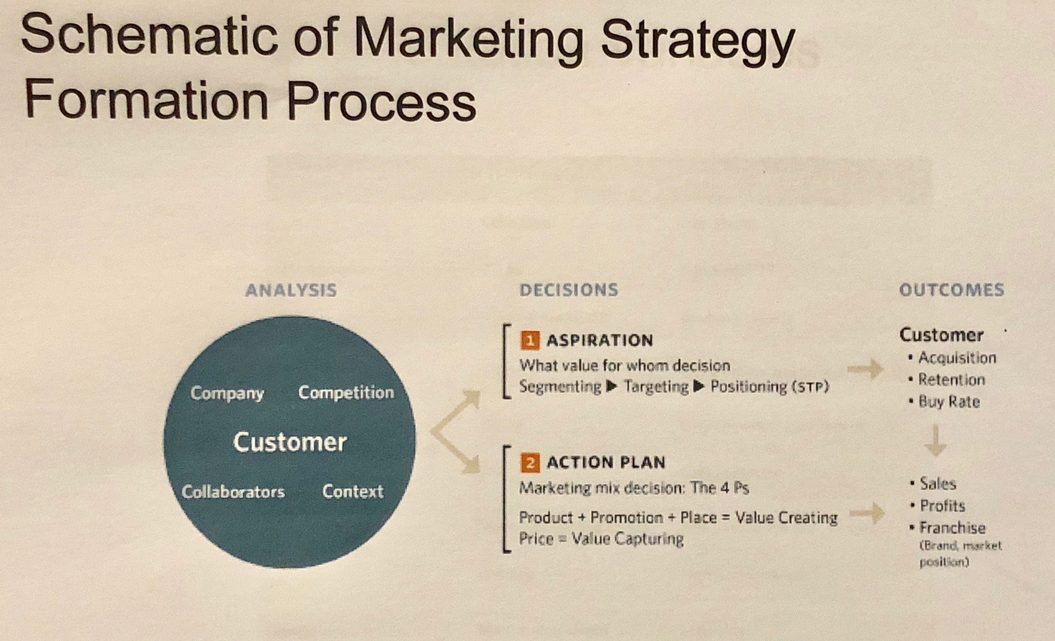
Marketing Strategy Formation Schematic
Analysis
Decisions
Outcomes

Slide 14
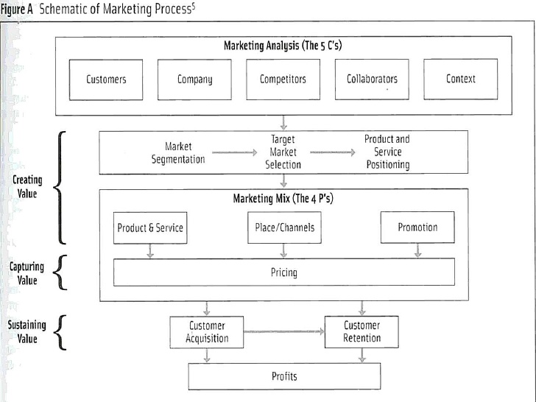
Framework for Marketing Strategy Formation

Slide 15
Analysis
The 5 C’s:
Customer Behavior which is supported by
Company (e.g. what special skills, competencies and assets does the organization bring to create and keep customers)
Collaborators – what suppliers can partner with the firm in its effort to attract and keep customers
Competition - who else is seeking to create and keep the same customers?
Context -

Slide 16
Aspiration Decision
The aspiration decision is what the firm hopes to achieve in the market
There are three steps:
SEGMENT – the market
TARGET – the specific customer group or groups to address
Determine the desired product or service POSITIONING
Abbreviated as STP

Slide 17
Positioning
How will we approach this market and what do we want segment members to see in us?
These are the essential elements:
The target customer as defined by the segmentation variables
The wants of that customer
The product type and category, as seen by the customer
The key benefit to be provided to the target customer

Slide 18
Philip kotler
“The advantage of solving the positioning problem is that it enables the company to solve the marketing mix problem.”

Slide 19
Action Plan: The Four P’s
Neil Borden originated the term “marketing mix” to describe the set of activities comprising of a firm’s marketing program
Ben Shapiro identified three areas of interaction in his HBR classic “The Marketing Mix” note written for class discussion in 1992 :
Consistency of mix elements – the minimum standard, implying a good fit
Integration – existence of positive, harmonious interaction
Leverage – where each element is used to its best advantage to support the value creation/capture of the overall mix

Slide 20
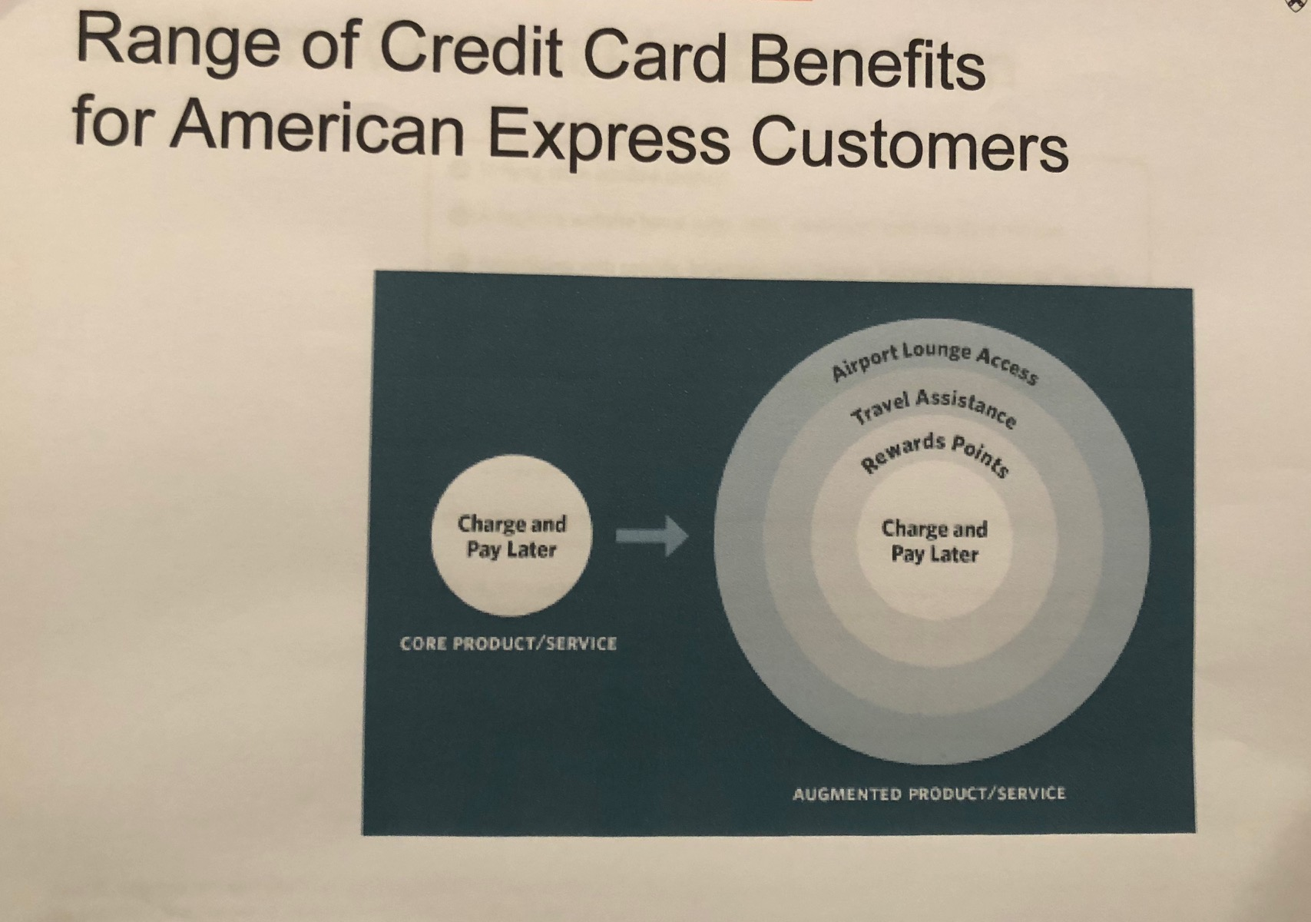
Product Decisions
The core function of a product is not what makes the sale in most situations
Marketers must think of the full sets of ways in which value can be created for customers: such as brand name, company reputation, ease of installation, ease of use, post-sale assistance, warranty

Slide 21
Product Decisions - Introduction
Defining products with this broad conception is the key to seeing possible valuable points of differentiation from competitors
In his 1986 book “The Marketing Imagination
Ted Levitt advocated” for the “Total Product View” approach which considers the product as “the full set of ways in which an offering can solve a customer’s problem”

Slide 22
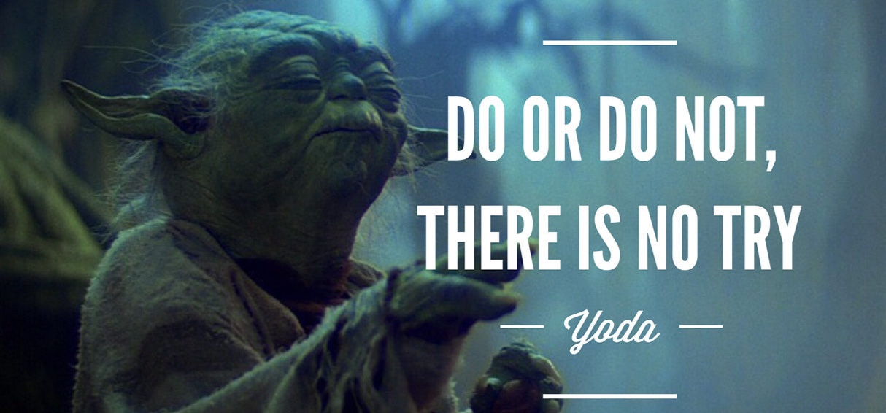
Yoda Says…

